Slide 1
ABSTRACTION
Abstract Keyword
Interface

Slide 2
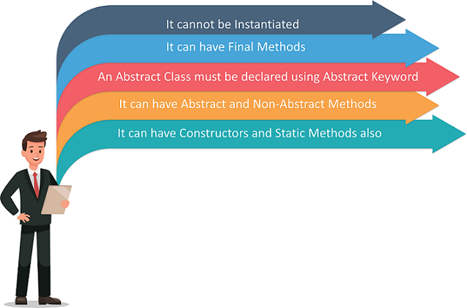
Abstract Classes in Java help to achieve abstraction
Rules for using Abstract Classes in Java

Slide 3
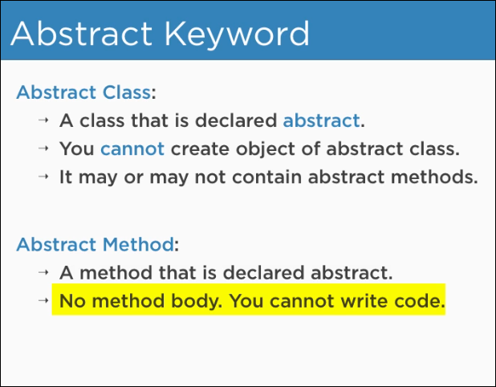

Slide 4
WAYS TO ACHIEVE ABSTRACTION IN JAVA
Implementing an Abstract Class
Implementing an Interface
THE SYNTAX FOR ABSTRACT CLASSES
abstract class Classname {}
abstract Method();

Slide 5
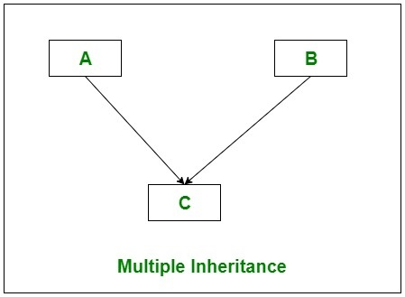
INTERFACE
Why we need an Interface?
Java does not support Multiple Inheritances
it results in Diamond Problem.

Slide 6
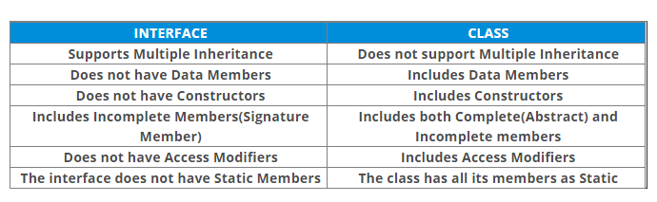
Declaring a Java Interface:
Syntax :
interface interface_name {
// declare constant fields;
// declare abstract methods();
}

Slide 7
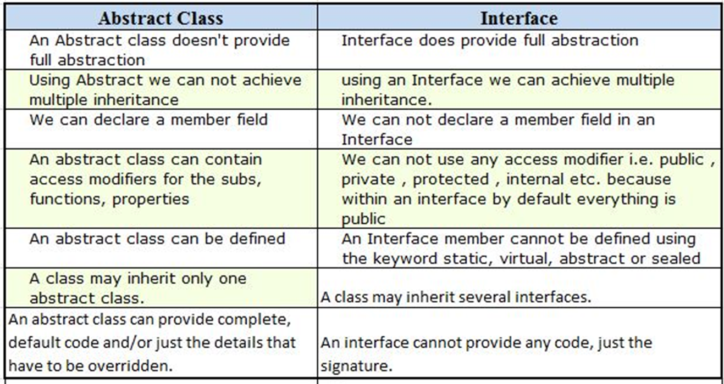

Slide 8
EXAMPLES

